Slide 1
Writing Papers in the Biological Sciences
An introduction to Biological research and paper writing

Slide 2
Chapter Nine: Using Writing to Prepare for Examinations
A general overview:
  Getting the most out of textbooks
  Taking good lecture notes
  Preparing for laboratory Exams
  Study for short-answer Questions
  Answering Essay Questions

Slide 3
Getting the most out of textbooks
Use highlighting carefully:
1- Highlighting is a useful reading strategy but only if used thoughtfully.
2- Avoid highlighting line for line as you are reading; it doesn’t allow you to make meaningful distinctions about the relative importance of successive sentences.
3- highlight selective points.

Slide 4
Annotate your textbooks.
1- Adding your own annotations : questions, notes, and other comments in the margins or elsewhere in the text.
2- Make difficult passages comprehensible by summing them up in your own words.
3- Used selectively with highlighting, annotation can individualize your texts and make information easier to access and retain.

Slide 5
Read chapter summaries and respond to review questions.
1- These study aids reflect the author’s expert insights about the most important material.
2- If your text does not have a chapter summary, write your own.
3- Write out the answers to end-of-chapter questions, even ones you think you understand; do not simply answer them in your head.

Slide 6
Taking good lecture notes
Be selective: Good lecture notes are a selective record and Many of your notes may be abbreviated versions of the lecturer’s own sentences.
Revise your notes as soon as possible:
Although reworking your notes after each lecture may seem time-consuming, it’s guaranteed to reinforce your understanding of the subject and make your studying more productive.
Keep up with assigned readings:
*Instructors write their lectures assuming students have acquired certain background knowledge by reading the textbook or other course materials.
*If you come to class with that knowledge, you are more likely to understand the lecture and to take coherent notes.

Slide 7
Preparing for laboratory exams
Remember the benefit of advance preparation: read both your text and your lab manual and understand how each lab’s exercise fits into the framework of the course as a whole.
When preparing drawings, use your text or other references to help you identify structures, but draw what you see; do not simply copy a stylized textbook illustration.
Label your diagram carefully and always print legibly; be sure to identify details using the correct terminology.

Slide 8
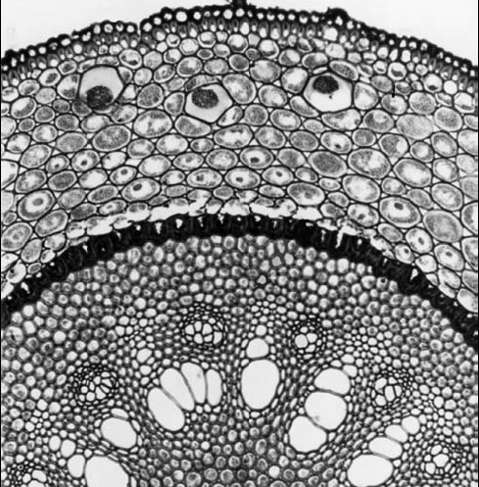
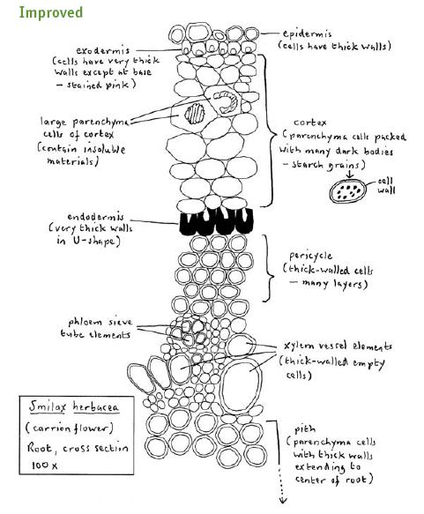
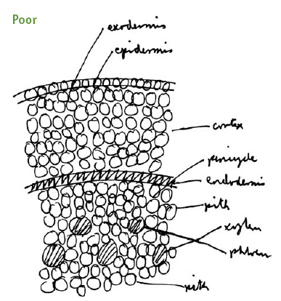

Slide 9
Study for short-answer questions
Create your own expanded “textbook.”
Compile a list of key terms.
Devise your own questions.
Do not become lost in details: focus on central issues.
Find a study partner, or create a study group (not always good!!)

Slide 10

Answering Essay Questions
Read through the entire test before you start. (start with the easy Qs)
Address the question asked.
Stick to the point.
Observe length restrictions on answers.
Plan before you start to write.
Develop a clear thesis.
Support general statements with specific evidence or examples.
Include illustrations, if appropriate.

Slide 11

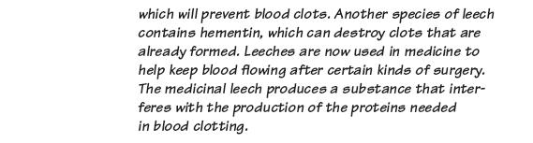
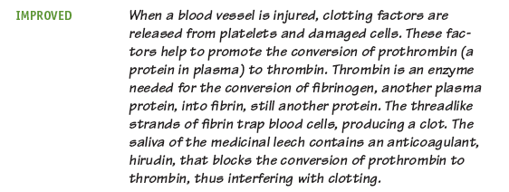

Slide 12
Why examinations?
Examinations are part of the learning process:
  An element in assessment
    The assessment has already started – Continuous Assessment
  Stimulus to order your thoughts
  Help you to think under pressure
  Satisfaction of knowing that you have studied
  Step on the way to your degree and future career

Slide 13
Revision
“going over a subject that has already been learnt”
  You are not seeing it for the first time!!!!
  Reviewing – putting into order all the material at your disposal e.g.
    Course outline
    Lecture Notes – lecturer’s handouts and your own
    Text Book
    Notes of your reading and study

Slide 14
How to Revise?
What works for you
    We are all different and work to different rhythms
Spread it out – don’t leave it to the end
Revise actively:
    Note-taking
    Learning – e.g. definitions
    Synthesizing – making connections
    Test yourself e.g. questions in text-book
    Half hour of active revision better than two just turning over the pages
    If you get stuck, take a break – walk, coffee etc

Slide 15

Exam Day
Read the instructions you will get before the examination carefully
Check the time-table for:
  Exam Dates
  Exam Times
  Exam Place
  First day check your seat on the plan
Arrive on time but not too early
    Comparing notes with others can make you nervous!!!.....

Slide 16
Examiner’s View of Exams
We are on your side!
  An exam not an attempt to trip you up
  We love to see you thinking!
  We do not have to meet a ‘failure quota!’
  Failing you means more work for us!
  We DO like you and want you to do well

Slide 17
I need to be able to read your paper, so write clearly!!!!.
  keep your handwriting neat
  use space intelligently
  skip a few lines between answers
  number answers as on exam paper
  no colours please!!.

